Slide 1
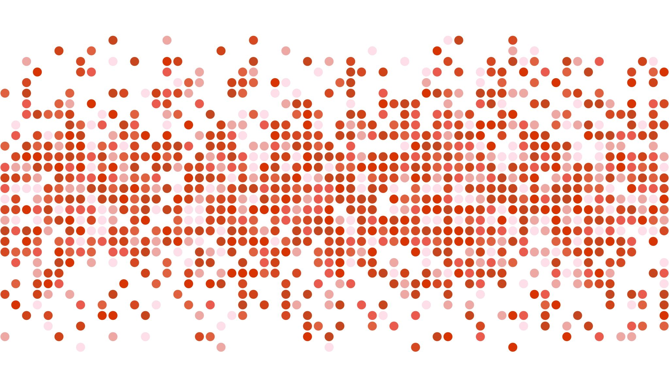
WEST NILE VIRUS PREDICTION
BY ESTHER, PRATCH, WAYNE (DSI-16)

Slide 2
PROBLEM STATEMENT
Due to a recent outbreak of the West Nile Virus in the city of Chicago, our Data Science team at the Disease and Treatment Agency has been tasked by the Centers for Disease Control (CDC) to develop a strategy to deploy the effective use of pesticides, by targeting spraying of pesticides to areas of high risk will help to mitigate future outbreaks.
Leveraging on weather, location, mosquito population and spraying data, the team will develop a binary classification model to predict the presence of the West Nile Virus in the city of Chicago.

Slide 3
DATA
Train & Test Dataset
Test results of mosquito traps with features such as
Date
Address
Species
Trap ID
Longitude
Latitude
Number of Mosquitos
WNVPresent
Weather Dataset
Weather data is from NOAA, containing the weather conditions from 2 weather stations:
Station 1: Chicago O’Hare International Airport
Station 2: Chicago Midway International Airport
Spray Dataset
Geographic Information Systems (GIS) data for City of Chicago's spray efforts to kill mosquitos in 2011 and 2013.
It contains data on the Date, Time, Longitude and Latitude of spray.

Slide 4
DATA SCIENCE WORKFLOW
Data Cleaning
EDA
Feature Engineering
Modelling
Model Evaluation

Slide 5
DATA CLEANING
Train & Test Dataset
No null values
813 duplicated rows
Test results are organized in such a way that when the number of mosquitos exceed 50, they are split into another record (another row in the dataset), such that the number of mosquitos are capped at 50.

Slide 6
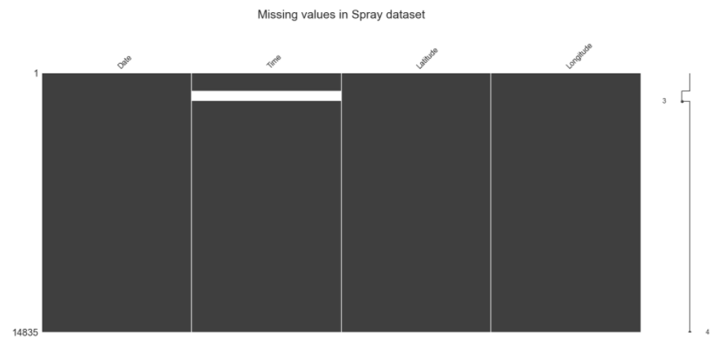


DATA CLEANING
584 missing values for ‘Time’
541 duplicated rows
Spray Dataset
All the missing values for ‘Time’ and duplicates occur on the same date ‘2011-09-07’

Slide 7
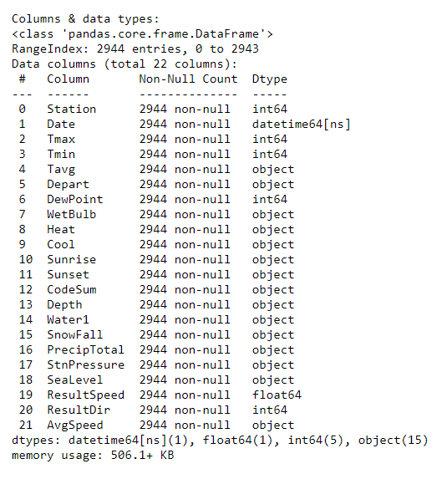

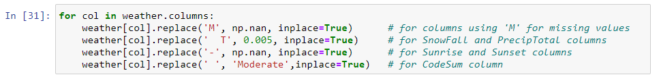
DATA CLEANING
Weather Dataset
At first glance, no missing value
Based on data dictionary, missing values are marked with ‘M’, trace value are marked with ‘T’.
Mapped to correct values

Slide 8
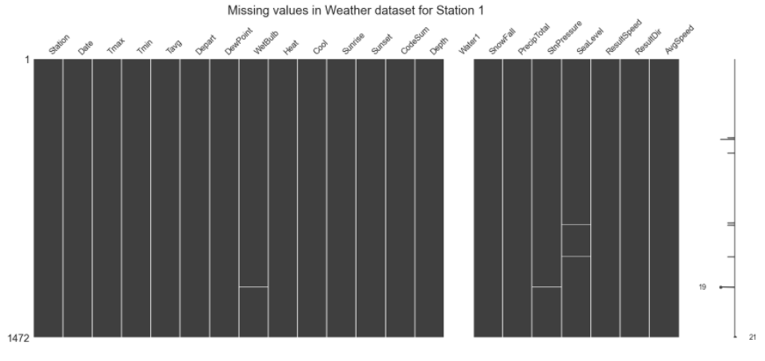
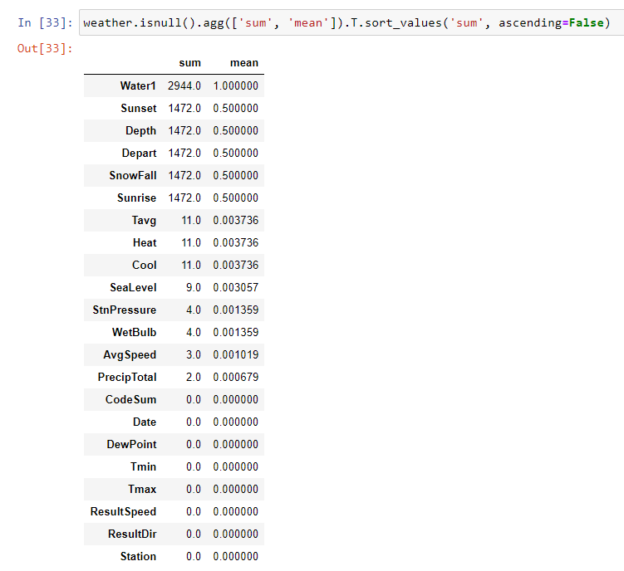
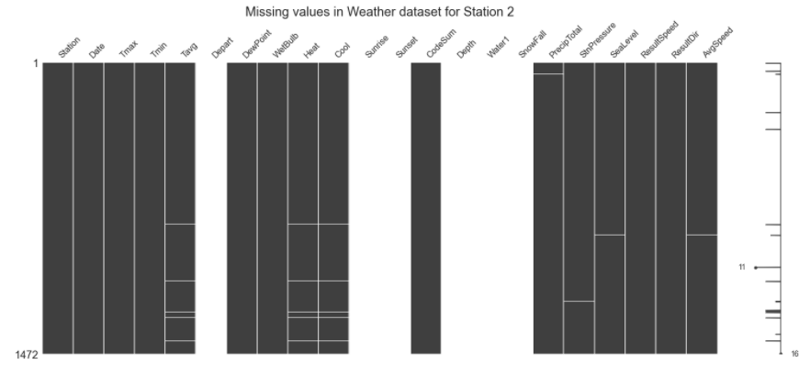
DATA CLEANING
Weather Dataset
Strategies to impute missing values:
Tavg: Mean of Same day Tmax and Tmin
Others: Available data from the other station

Slide 9
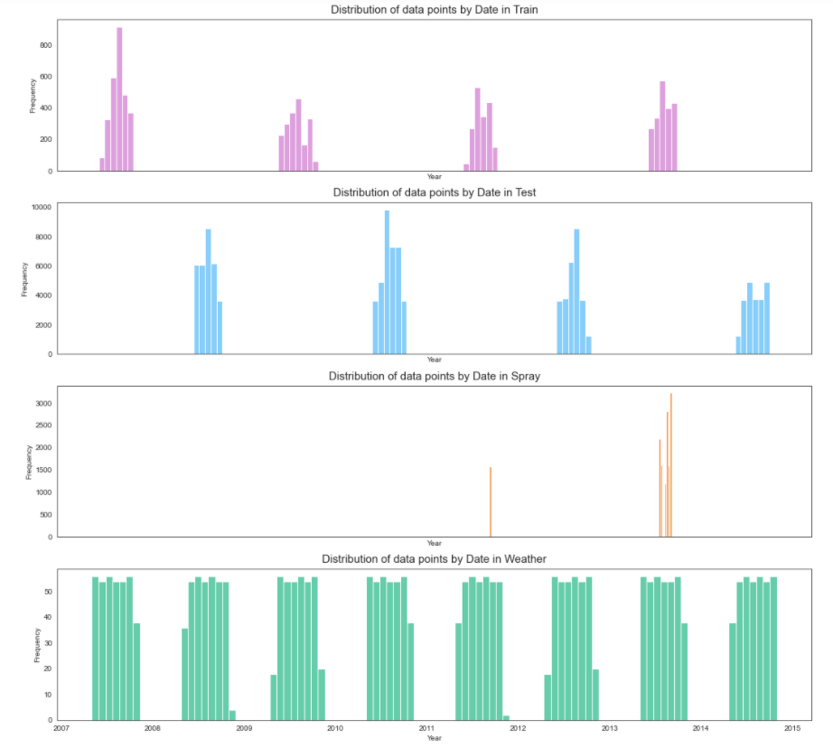
EDA
Train dataset:
Year 2007, 2009, 2011, 2013
Test dataset:
Year 2008, 2010, 2012, 2014
Spray dataset:
Year 2011, 2013
Weather dataset:
Year 2007 to 2014

Slide 10
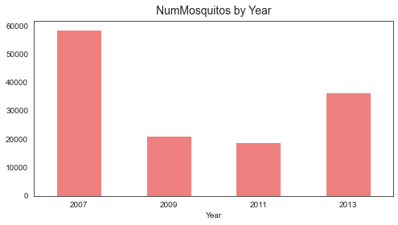
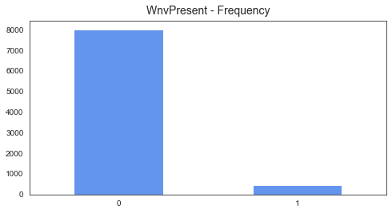
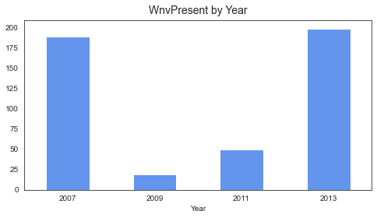
EDA
WNVPresent & NumMosquitos
Imbalanced dataset
Class 1: 5%
Class 0: 95%

Slide 11
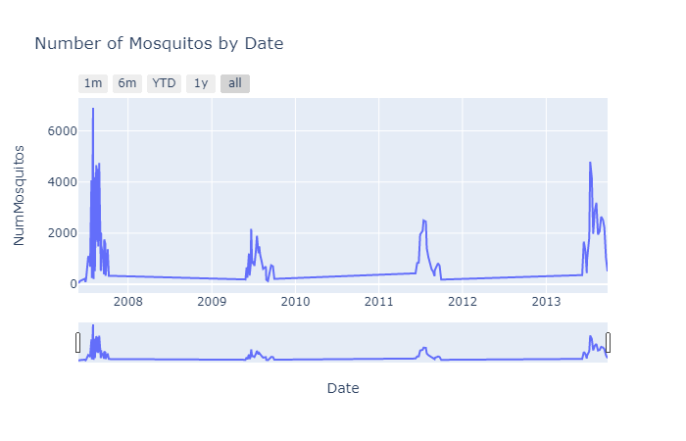
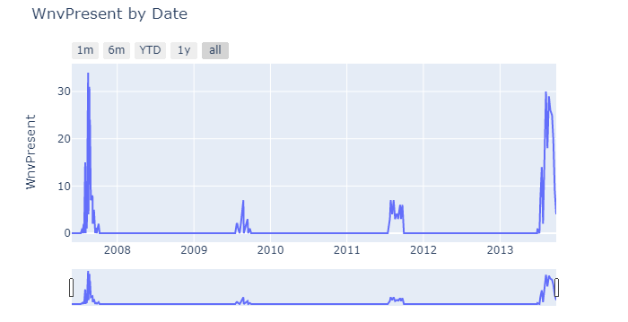
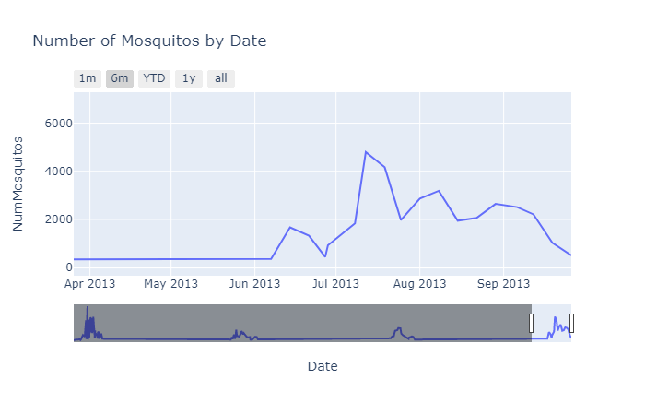
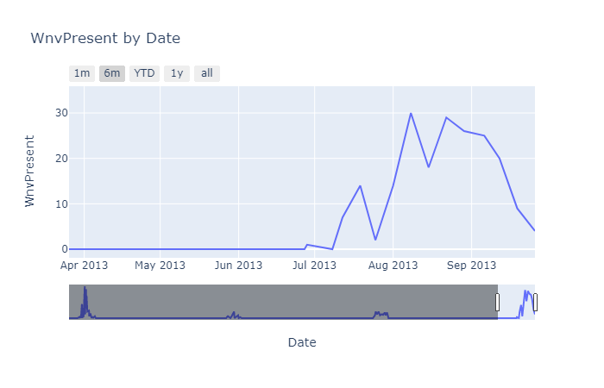
EDA
Number of Mosquitos & WnvPresent peak in Mid July to August every year

Slide 12
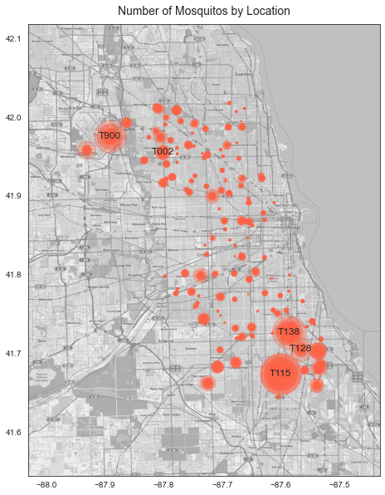
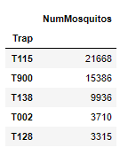
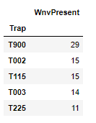
EDA

Slide 13
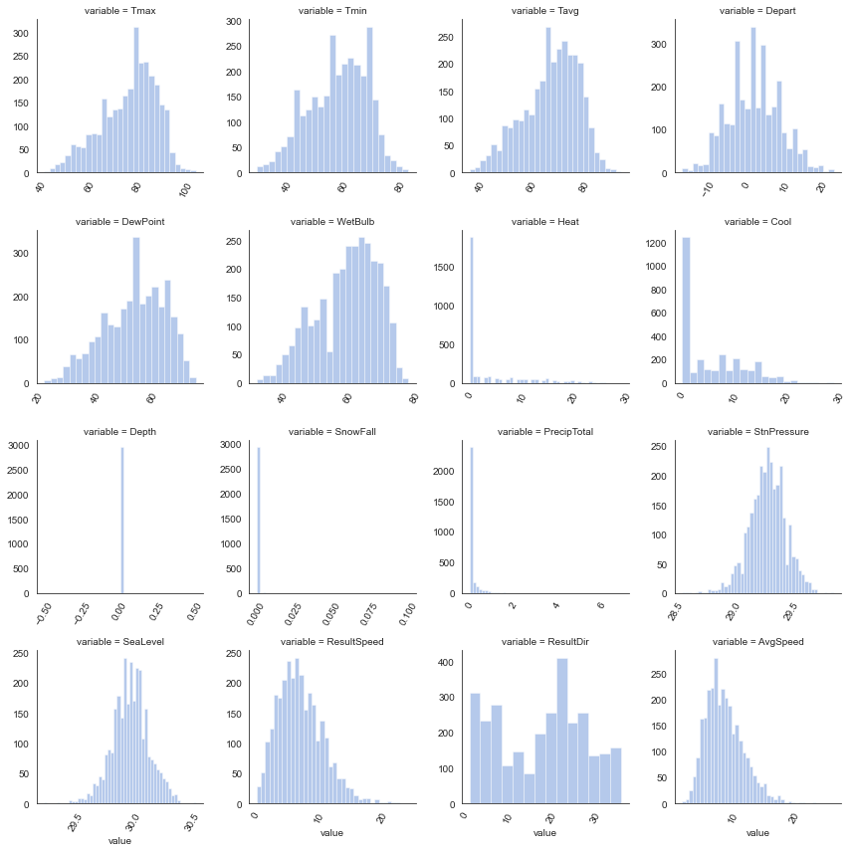
EDA
Weather

Slide 14
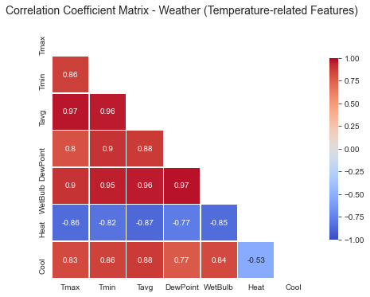
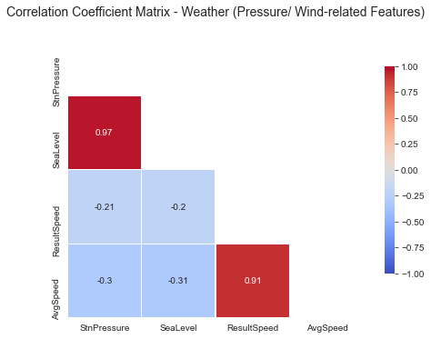
EDA
Weather
Features to keep: Tavg, PrecipTotal, StnPressure, AvgSpeed

Slide 15
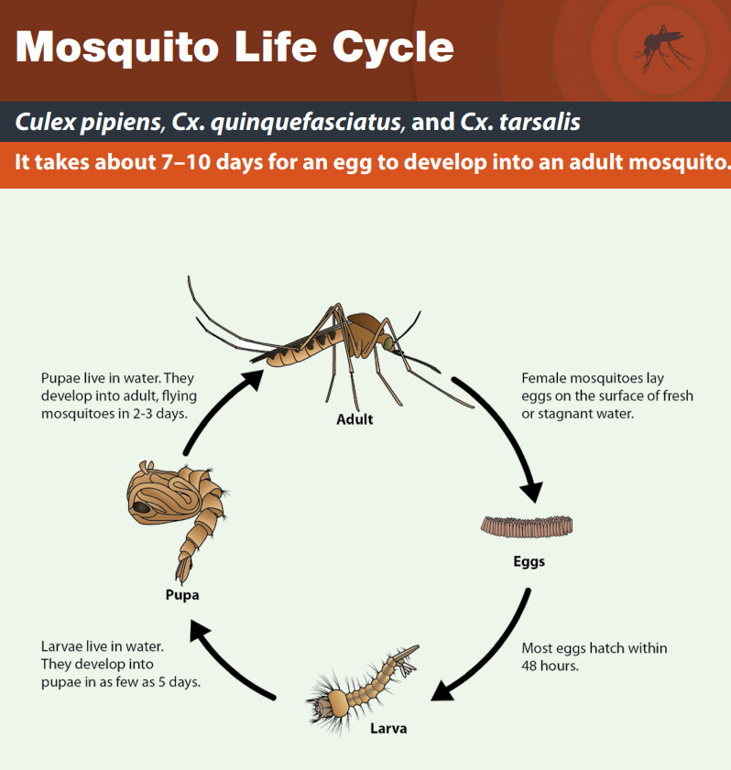
FEATURE ENGINEERING
1. Weather: Breeding Window
Mosquito life cycle: 7-10 days from egg to adult mosquito
T-10 days
T-7 days
T
Breeding window
Weather condition should be conducive
Engineer weather features with rolling average of 4 days, then shift by 7 days

Slide 16
FEATURE ENGINEERING
2. Weather: Optimal Temperature Range
According to research, the optimal temperature for mosquito breeding is between 50 degree (minimum to be active) and 80 degree (for maximum activeness).
Based on this, we will build a new feature to indicate whether or not the Mean Tavg in T-7 to T-10 days is within optimal temperature range:
1: Within optimal temperature range (50 to 80)
0: Not within optima temperature range (50 to (80)
3. Train/ Test Dataset: Species & Trap
One Hot Encoding

Slide 17
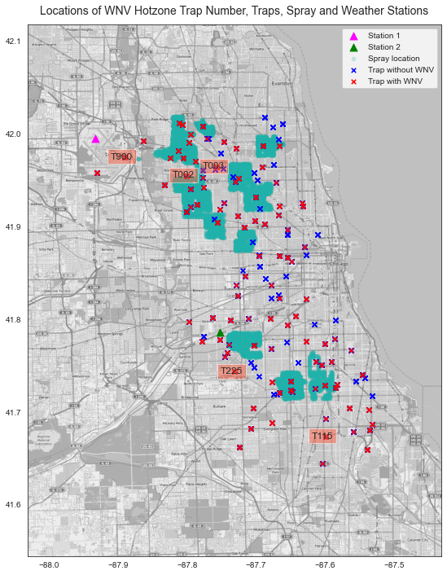
MAPPING OF WEATHER DATA TO TRAIN/ TEST DATA
For each trap location, we calculate the distance between the trap to weather station 1 and 2
Then map the weather data from the nearest station to the train and test dataset

Slide 18
MODELLING
Key Metrics:
ROC AUC score
Sensitivity
False Positives are better than False Negatives!
Handling of Imbalanced Data:
Apply SMOTE oversampling if the classifier model does not handle imbalanced data

Slide 19
MODELLING
Model | Strategy to Handle Imbalanced Data
Logistic Regression | SMOTE
Random Forest | Class Weighting
AdaBoost | SMOTE
GradientBoost | SMOTE
XGBoost | scale_pos_weight

Slide 20
MODEL EVALUATION
 | Training ROC AUC | Validation ROC AUC | Sensitivity | Accuracy
Logistic Regression (with SMOTE) | 0.78 | 0.80 | 0.68 | 0.77
Random Forest (with class weighting) | 0.83 | 0.81 | 0.77 | 0.75
AdaBoost (with SMOTE) | 0.81 | 0.80 | 0.56 | 0.81
GradientBoost (with SMOTE) | 0.84 | 0.83 | 0.65 | 0.81
XGBoost (with scale_pos_weight) | 0.85 | 0.83 | 0.85 | 0.65

Slide 21
MODEL EVALUATION
 | Training ROC AUC | Validation ROC AUC | Sensitivity | Accuracy
Logistic Regression (with SMOTE) | 0.78 | 0.80 | 0.68 | 0.77
Random Forest (with class weighting) | 0.83 | 0.81 | 0.77 | 0.75
AdaBoost (with SMOTE) | 0.81 | 0.80 | 0.56 | 0.81
GradientBoost (with SMOTE) | 0.84 | 0.83 | 0.65 | 0.81
XGBoost (with scale_pos_weight) | 0.85 | 0.83 | 0.85 | 0.65

Slide 22
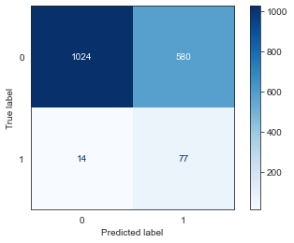
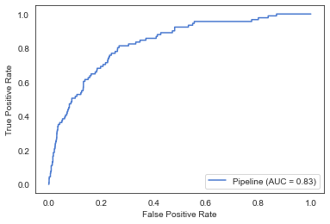
BEST MODEL: XGBOOST
Kaggle Score (Test ROC AUC): 0.77363

Slide 23
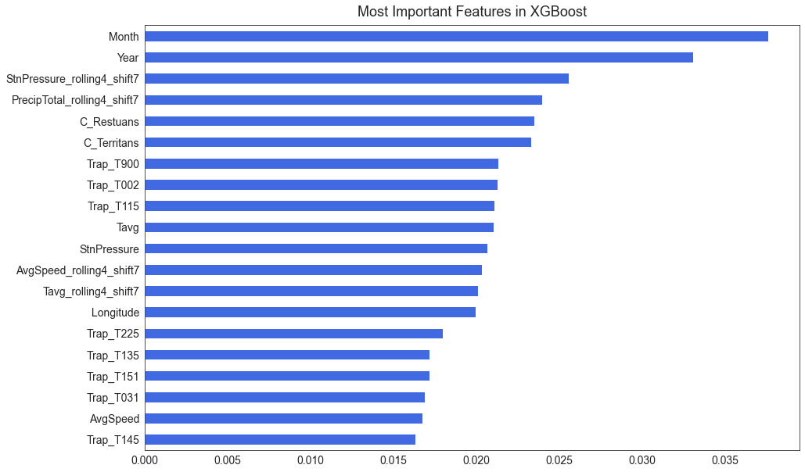
BEST MODEL: XGBOOST
Seasonality
Weather
Species
Location

Slide 24
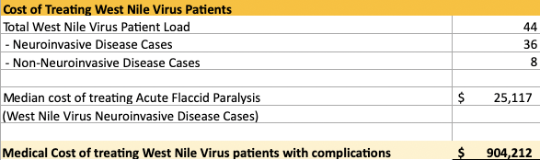
COST BENEFIT EVALUATION
Scenario 1: No Spraying
36 Neuroinvasive Disease Cases Total Cost - $904,212

Slide 25
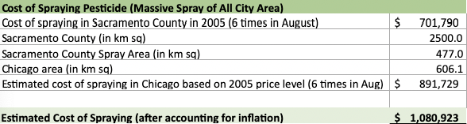
COST BENEFIT EVALUATION
Scenario 2: Massive Spraying
Total Cost of Mass Spraying - $1,080,923

Slide 26
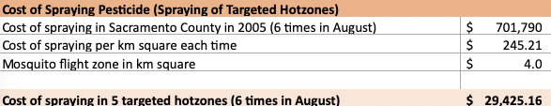
COST BENEFIT EVALUATION
Scenario 3: Spraying Targeted Hotzones
Total Cost of Targeted Spraying - $29,425

Slide 27

COST BENEFIT EVALUATION
Scenario | No Spraying | Mass Spraying | Targeted Spraying
Cost | Medical Cost | Spraying all Chicago city (6 times during peak period) | Spray top 5 mosquito hotzones (6 times during peak period)
Total Cost | $904,212 | $1,080,923 | $29,425

Slide 28
CONCLUSION
XGBoost:
Highest ROC AUC Score:
Train 0.85
Test 0.83
Most Important Features:
Traps - Locations
Seasonality - Month and Year
Temperature - Weather
Cost Benefit Analysis:
Targeted Spraying
TOP 5 Hotzones
6x During Peak Period
Total Cost $29,425
Notes:
While XGBoost had the lowest accuracy of 0.65, it was still selected as it performed the best with the highest ROC AUC score of 0.85 on the train set and 0.83 on the validation set. As seen in the explanation of the most important features in XGBoost, it turns out that traps(location), seasonality(month and year) and temperature(weather) plays an important predictor in classifying the presence of WNV in the city of Chicago, receiving a kaggle score of 0.71 on completely unseen data.
The cost benefit analysis was done on the basis of medical cost on Neuroinvasive disease cases as they have a higher medical costs . Based on the cost benefit analysis, as long the city has more than 36 cases in a year($904,212), it would be more cost effective to spray as the medical cost alone would be greater than the effective spraying costs($1,080,923).

Slide 29
RECOMMENDATION
Precise Pesticide Deployment
Based on :
SEASONALITY (Jul to Aug)
TIMING (every 7-10 days after rain)
LOCATION (Top 5 mosquito hotspots)
1
2
Educational Programmes
Encouraging communities to take responsibility
Increased frequency in hotzones
Notes:
Recommendations
Pesticide Deployment
Educations Programme
To further improve on the cost-effectiveness of pesticide deployment, the city council could reconsider where and when such pesticide are deployed as the breeding of mosquitoes are heavily dependent on weather and timing(in terms of days). Spraying should be focused on months of the year where there is generally higher rainfall(Jun to Jul) and target specific locations/areas where a high number of mosquitoes have been proven to breed in higher numbers. The timing of the spraying would also drastically affect the effectiveness in lower the numbers of mosquitoes. Pesticide deployments should be schedule to take place in a 1 to 2 week window period after days of rainfall as that is the general time period for the mosquito population to spike in favourable environments.

Slide 30
FURTHER WORK
Better way of treating trap location data ⇒ Clustering into zones
Use more recent data to model (e.g. WNV Forecasting Challenge 2020)

Slide 31
THANK YOU :D

